Slide 1
Contrast Enhancement of Satellite Images Using Histogram Equalization
Nahom Abera

Slide 2
Agenda:
Slide 3: Abstract
Slide 4 - 6 : Introduction, Background, Problem Statement and Objectives
Slide 7: Literature Review
Slide 8: Dataset Description
Slide 9: Implementation and Methodology
Slide 10: Performance Metrics Calculation
Slide 11: Data Storage and Analysis
Slide 12 - 14: Results
Slide 15 - 17: Conclusion, Implications and Limitations
Slide 18: References

Slide 3
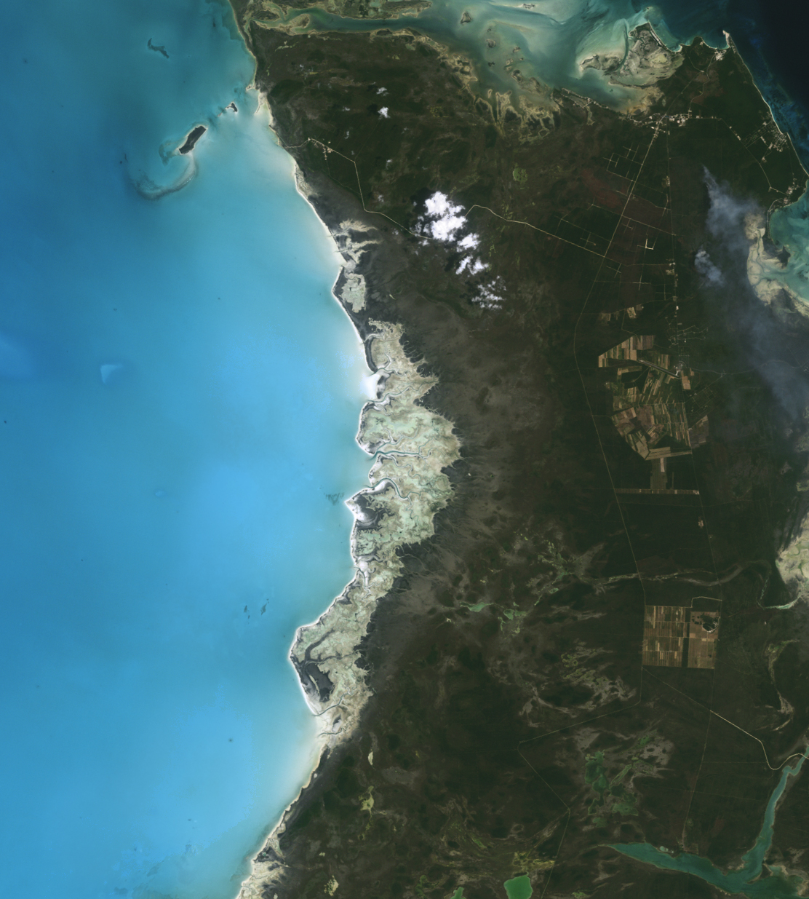
Abstract
Satellite imagery is crucial for applications like urban planning, environmental monitoring, and disaster management.
Enhancing contrast and visibility is essential for accurate analysis.
This study explores Global Histogram Equalization (HE) and Contrast-Limited Adaptive Histogram Equalization (CLAHE) on both grayscale and color satellite images.
Dataset: RSI-CB256 from Kaggle (5,631 images across four classes).
Metrics Used: Peak Signal-to-Noise Ratio (PSNR) and Structural Similarity Index (SSIM).

Slide 4
Introduction
Importance of Satellite Imagery:
Critical for urban planning, environmental monitoring, disaster management.
Clarity and contrast are vital for accurate interpretation.
Challenges:
Low contrast due to atmospheric conditions and sensor limitations.
Solution:
Applying histogram equalization techniques to enhance image contrast.

Slide 5
Background
Histogram Equalization (HE):
Enhances contrast by redistributing image intensity values.
Global HE considers the entire image.
Contrast-Limited Adaptive Histogram Equalization (CLAHE):
Applies HE locally on small regions (tiles).
Prevents over-enhancement of noise.

Slide 6
Problem Statement and Objectives
Problem Statement:
Low contrast in satellite images hinders terrain feature identification.
Main Objective:
Enhance satellite image contrast using Global HE and CLAHE.
Specific Goals:
Improve visibility of key features of the satellite image.
Compare effectiveness across different terrains and conditions.

Slide 7
Literature Review
Zuiderveld (1994):
Introduced CLAHE for medical imaging.
Improved local contrast without over-enhancing noise.
Landgrebe (2003):
Applied HE and CLAHE in remote sensing.
Enhanced image clarity for better classification accuracy.
Mather & Tso (2016):
Emphasized contrast enhancement in terrain classification.
CLAHE maintained feature clarity across varied terrains.

Slide 8
Dataset Description
RSI-CB256 Dataset
Total Images: 5,631 JPEG images.
Classes:
Cloudy (1,500 images)
Desert (1,131 images)
Green Area (1,500 images)
Water (1,500 images)
Image Size: 256×256 pixels.
Why This Dataset?
Diverse terrains and environnemental conditions.
Ideal for comprehensive analysis.

Slide 9
Implementation and Methodology
Data Loading and Preprocessing:
Images read from class-specific folders.
Converted to grayscale and processed in color.
Enhancement Techniques:
Global HE:
Grayscale: Applied directly.
Color: Applied to Y channel in YCrCb color space.
CLAHE:
Grayscale: Applied with contrast limiting.
Color: Applied to Y channel to enhance local contrast.

Slide 10
Performance Metrics Calculation
Peak Signal-to-Noise Ratio (PSNR):
Measures image quality compared to the original.
Structural Similarity Index (SSIM):
Assesses luminance, contrast, and structure preservation.
Adjustments:
The window size parameter adjusted for small images.
The channel axis specified for color images.

Slide 11
Data Storage and Analysis
Results Compilation:
PSNR and SSIM values for each image, method, and color space.
CSV Files:
Results saved for record-keeping and analysis.
Average Metrics Calculation:
Computed for each method and color space.

Slide 12
Quantitative Results
Average Metrics:
Interpretation:
Grayscale:
Both methods show low PSNR and SSIM values.
Minimal differences between HE and CLAHE.
Color:
Higher PSNR and SSIM indicate better quality preservation.
HE slightly outperforms CLAHE.
Method | Color Space | Average PSNR (dB) | Average SSIM
HE | Grayscale | 8.894570 | 0.227058
CLAHE | Grayscale | 8.977763 | 0.226548
HE | Color | 25.175466 | 0.839225
CLAHE | Color | 25.167423 | 0.834887

Slide 13
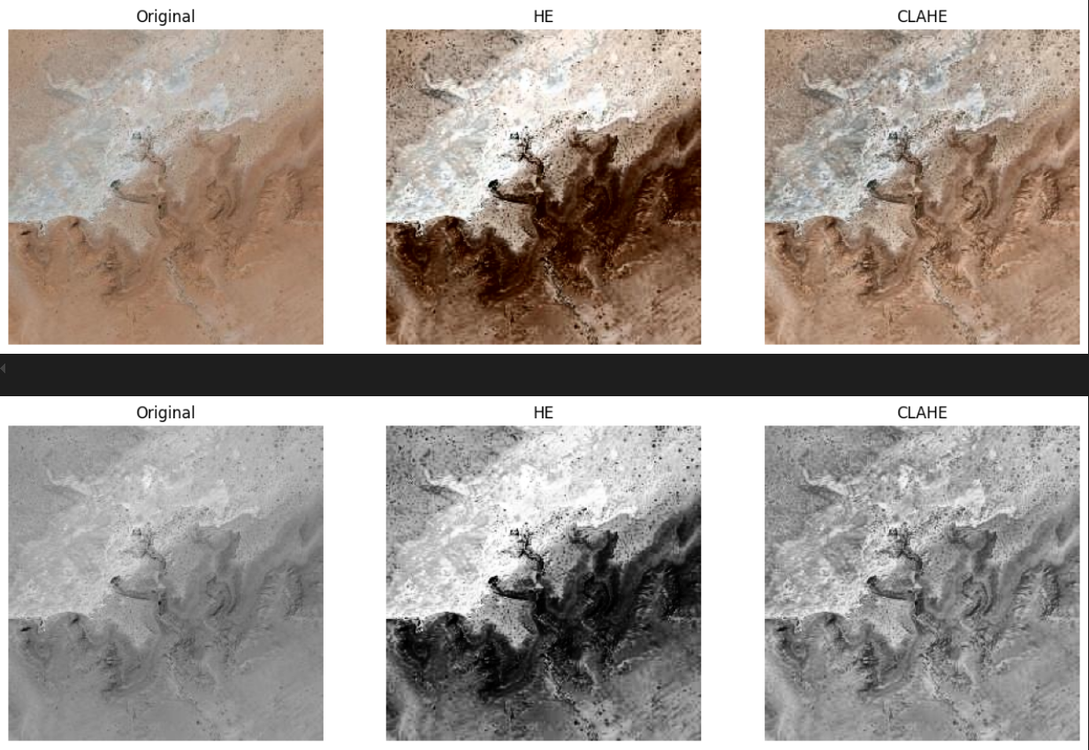
Qualitative Results
Top Row (Color Images):
Original: Natural terrain features with earthy tones.
HE: Darker image with enhanced contrast; shadows and highlights exaggerated.
CLAHE: Balanced contrast enhancement; details enhanced while maintaining natural tones.
Bottom Row (Grayscale Images):
Original: Relies on brightness and contrast variations.
HE: Increased contrast; bright and dark regions more distinct but may appear intense.
CLAHE: Smoother contrast enhancement; finer details highlighted without over-intensification.

Slide 14
Qualitative Results: Observations
HE vs. CLAHE:
Color Images:
HE enhances global contrast but may distort natural colors.
CLAHE improves local contrast without significant artifacts.
Grayscale Images:
HE may cause over-intensification.
CLAHE maintains a more natural appearance.
Preservation of Natural Appearance:
CLAHE better preserves natural tones and textures.
HE may introduce over-saturation and unnatural contrasts.

Slide 15
Conclusion
Color Images:
HE slightly outperforms CLAHE in PSNR and SSIM.
CLAHE preserves natural appearance and enhances local details.
Choice depends on whether global contrast or naturalness is prioritized.
Grayscale Images:
Both methods yield similar quantitative results.
CLAHE provides better qualitative enhancement without over-intensification.

Slide 16
Implications
Method Selection:
For Color Images:
Use CLAHE for preserving natural tones and enhancing local details.
HE suitable for global contrast enhancement.
For Grayscale Images:
CLAHE recommended for balanced enhancement.
Enhancement Effectiveness:
CLAHE's balanced enhancement is valuable for detailed analysis.

Slide 17
Limitations
Dataset Resolution:
Small image size (256×256 pixels) may limit generalizability.
Affects effectiveness of enhancement techniques.
Metric Sensitivity:
PSNR and SSIM may not fully capture perceptual quality.
Additional metrics or subjective evaluations needed.

Slide 18
References
Zuiderveld, K. (1994). Contrast Limited Adaptive Histogram Equalization. In P. S. Heckbert (Ed.), Graphics gems IV (pp. 474-485). Academic Press.
Landgrebe, D. (2003). Signal Theory Methods in Multispectral Remote Sensing. John Wiley & Sons.
Mather, P. M., & Tso, B. (2016). Classification Methods for Remotely Sensed Data (2nd ed.). CRC Press.

Slide 19
Thanks!

